Slide 1
Chapter 5 (Sequential structure problem)
Nida Munawar

Slide 2
Sequential structure problem
The seventh step in solving the problem is to test the solution to catch any errors in logic or calculation. Remember, the charts are aids to the efficient development of a well-written program. They will not be perfect the first time around and will often need several revisions.

Slide 3
Seven steps for problem solving
1. The problem analysis chart—helps you define and understand the problem,
develop ideas for the solution, and select the best solution.
2. The interactivity chart—breaks the solution to the problem into parts.
3. The IPO chart—helps define the input, the output, and the processing steps.
4. The coupling diagram and the data dictionary designate the data flow
between modules. The data dictionary records information on the items.
5. The algorithms define the steps of the solution.
6. The flowcharts are a graphic form of the algorithms.
7. The pseudocode presents a generic language representation of the algorithm.

Slide 4
Problem:
Problem: Mary Smith is looking for the bank that will give the most return on her money over the next five years. She has $2,000 to put into a savings account. The standard equation to calculate principal plus interest at the end of a period of time is
where P Principal (amount of money to invest, in this case $2,000)
I Interest (percentage rate the bank pays to the investor)
N Number of Years (time for which the principal is invested)
M Compound Interval (the number of times per year the interest is calculated and added to the principal)
Amount = P * (1 + I/M) ^ (N * M)

Slide 5
Problem Analysis
The first step in analyzing the problem is to understand what is needed and what is given and to separate them from all of the nonessential information in the problem. Write down the input in the Given Data section and the output in the Required Results section. Record the processing that the problem demands in the section of the problem analysis chart headed Required Processing.

Slide 6
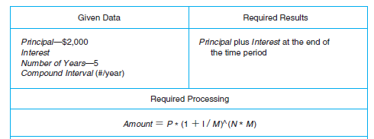
PAC
Problem Analysis Chart—Interest Problem

Slide 7
The Interactivity Chart
At this point, you can develop the interactivity chart. To complete the interactivity chart you have to answer the question: How can I divide this problem into smaller, more manageable parts?The interest problem is broken into four modules:
1. The InterestControl module, which controls the solution
2. The Read module, which enters the data
3. The Calc module, which calculates the amount
4. The Print module, which prints the result

Slide 8
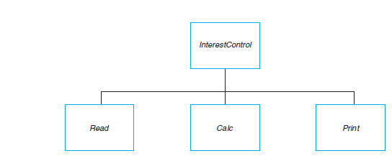
HIPO/IC
The Interactivity Chart—Interest Problem

Slide 9
HIPO/IC
The solution requires only that
data be entered,
that a calculation be performed,
and that the results be printed.
Each box represents a module. Each module has a function and represents two or more
instructions. The modules are numbered according to their level.

Slide 10
The IPO Chart
Now the IPO chart can be developed from the problem analysis chart and the interactivity chart. To complete the IPO chart you have to answer the question:
How can the input be processed to achieve the required output? You will provide general instructions for the solution on the IPO chart. You will not write the specific instructions to the computer until you complete the algorithms and the flowcharts.
Remember to start with the output, next specify the input, and then develop the processing method required to calculate the output from the input.

Slide 11
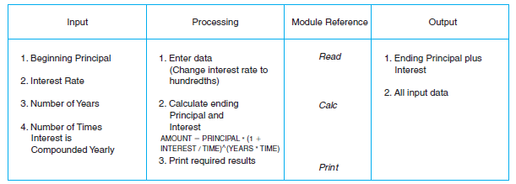
IPO:
The IPO Chart—Interest Problem

Slide 12
The Algorithms and Flowcharts
Once the structure chart and the IPO chart are completed, you can proceed with the
algorithms and the flowcharts. To complete an algorithm, you have to answer the question:
How can this module complete its function?
To draw the flowchart, you answer the question:
How does the algorithm look graphically?
By using the completed algorithms and the flowcharts, you can find and correct logic errors.
There are four algorithms, one for each module in the structure chart,
and their corresponding flowcharts.
The InterestControl module uses a sequential structure to execute the instructions, as do each of the other modules. Notice how the instructions simply flow in order from the top to the bottom of each algorithm.

Slide 13
Algorithm, Flowchart, and Pseudocode

Slide 14
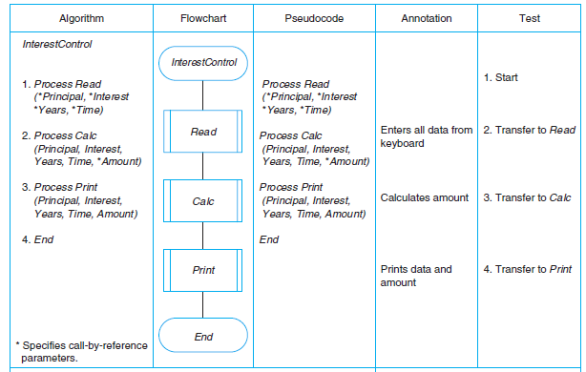
InterestControl Module:

Slide 15
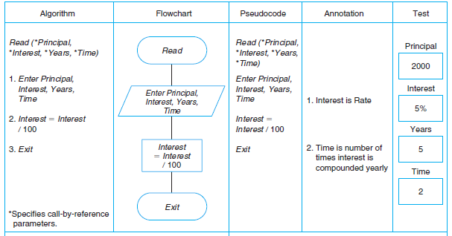
Read Module:

Slide 16
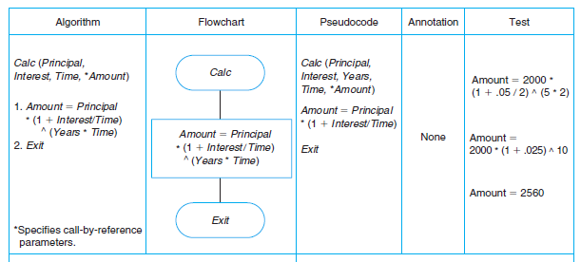
Calc Module:

Slide 17
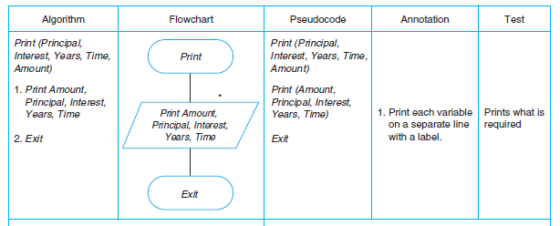
Print Module:

Slide 18
Home Task
Create a Flowchart for visiting a hospital using loops and decision structure

Slide 19
Assignment
Solve all the problems of chapter 5 (Page no 102 to 103)
Problem Solving, Programming Concepts 9th Ed - Sprankle and Hubbard

